Slide 1
LLM Agents
GTech

Slide 2
Content
Introduction to LLM Agents
What makes an LLM Agent Different?
Core components of an LLM Agent
How LLM Agents use tools
Amazon Bedrock Action Groups
Memory and Planning in LLM Agents
Knowledge Bases and Agentic RAG
Core Interpreter and Other Agent capabilities
Deploying Agents in Amazon Bedrock
Conclusion

Slide 3
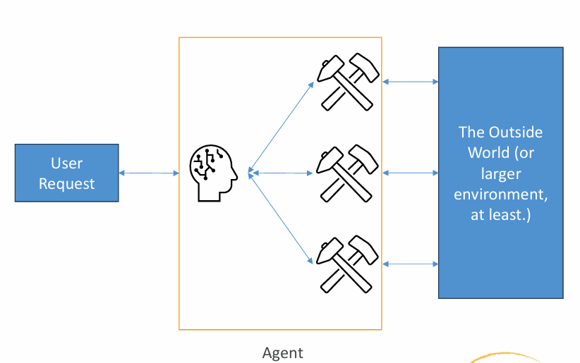
Introduction to LLM Agents
LLM stands for Large Language Model
Am LLM agent uses a language model to work toward a goal
It can choose tools to help answer a request
It can break a complex task into smaller steps
It can use conversation history and external information
Amazon Bedrock supports building LLM agents

Slide 4
What makes an LLM Agent Different?
A basic LLM responds using its input and learned knowledge
An agent can decide when to use external tools
It can retrieve information beyond the initial prompt
It can perform a sequence of steps
It uses instructions to guide its decisions
Its actions should be limited by appropriate permissions and safeguards.

Slide 5
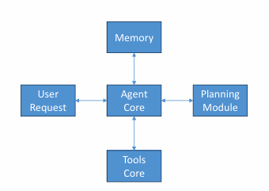
Core Components of an LLM Agent
LLM: Understands the request and helps choose the next step
Memory: Provides relevant conversation history or external data
Planning: Helps break a request into smaller tasks
Tools: Let the agent retrieve information or perform actions
Prompts: Explain how and when tools should be used
User request: Defines the task the agent needs to address

Slide 6
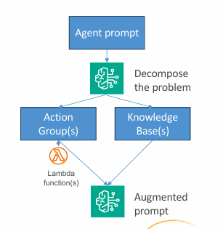
How LLM Agents Use Tools
Tools are functions that an agent can call
Tools connect the LLM to external systems
They can retrieve data aor perform specific tasks
In Amazon Bedrock, a tool can be connected through an AWS Lambda function
Tool prompts describe when and how to use each tool
The tool returns a result that helps the agent respond

Slide 7
Amazon Bedrock Action Groups
Action Groups define actions an agent can use
They connect the agent to functions or APIs
AWS Lambda can execute the required function
Each action needs a name and description
Parameters define the information the function expects
The agent may ask the user for missing required information

Slide 8
Memory and Planning in LLM Agents
Memory provides relevant information from previous interactions
It may use conversation history and external data stores
Planning helps divide a request into smaller tasks
The LLM uses instructions to decide the next step
tools can help complete individual tasks
The agent combines the results to prepare a response

Slide 9
Knowledge Bases and Agentic RAG
Knowledge Bases provide access to relevant external information
They can help an agent answer questions using supplied documents
The agent’s prompt guides when to use a Knowledge Base
RAG retrieves information for the LLM
Agentic RAG lets an agent use retrieval as a tool
Retrieved information can help ground the final answer

Slide 10
Code Interpreter and Other Agent Capabilities
Agents can use different tools for different tasks
A Knowledge Base can retrieve relevant documents
Lambda functions can connect to APIs and services
Other tools may access external information or Python modules
An optional Code Interpreter can execute code for supported tasks
Tool choice depends on the user’s request and agent instructions

Slide 11
Deploying Agents in amazon Bedrock
Configure the agent, its instructions, and available tools
Connect Action Groups and Knowledge Bases as needed
Test the agent before making it available to users
Create an agent alias for deployed version
Applications can call the agent using the InvokeAgent operation
Monitor usage, permissions, performance and cost

Slide 12
Conclusion
LLM agents use language models to work toward specific goals.
Memory and planning help manage multi-step tasks.
Tools connect agents to external data, APIs, and services.
Amazon Bedrock supports agents through Action Groups and Knowledge Bases.
Effective agents combine clear instructions, useful tools, and human oversight.

Slide 13


